Slide 1



WhistleSafe
Empowering Whistleblowers with a Centralized, Anonymous Reporting Platform Leveraging AI and Secure Communication
Team Name :Fellowship of Errors

Slide 2

SOLUTION OVERVIEW
Theme : Public Safety and Security
Problem :
There is a common situation worldwide where many people see wrongdoings but can't act due to fear and lack of protection.​
Our Solution :
Our platform offers a secure and anonymous way for people to report such incidents without fear of retaliation.
Our platform uses advanced technologies like AI to detect the fake reporting and secure communication methods to empower citizens report anonymously.
Whistle Safe is not just an idea; it is a solution crafted through real-world experiences and driven by a passion for justice and accountability.

Slide 3
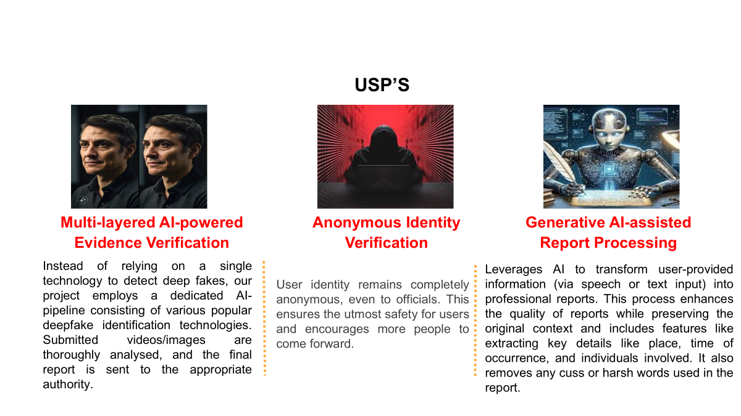

Slide 4
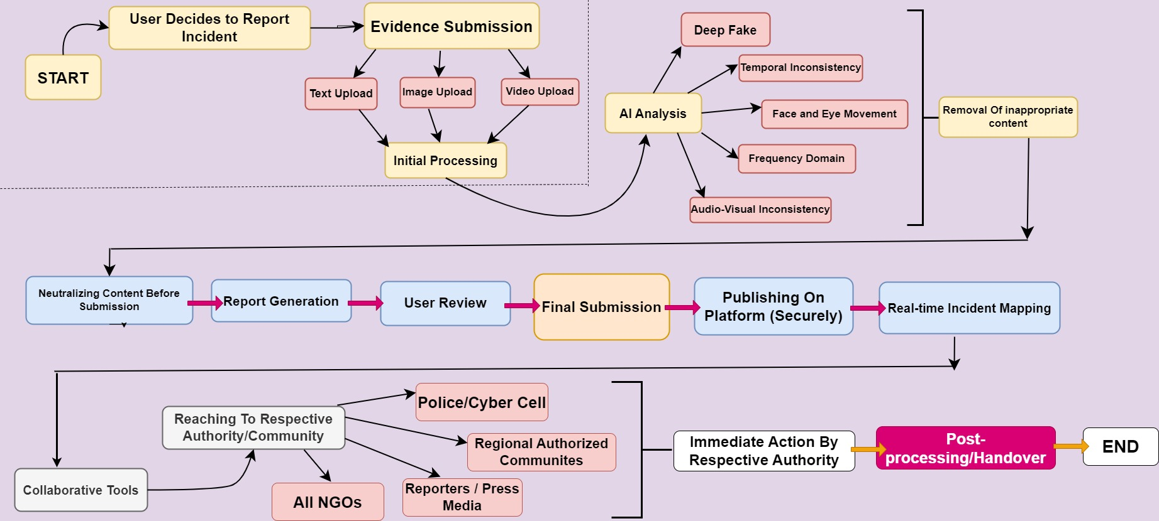
WORKFLOW
Workflow

Slide 5
TECHNICAL ARCHITECTURE
Tech stack
Frontend Technologies: React
Backend Technologies: Appwrite
Database: Appwrite
Other Tools/Services: MUI , Github , IBM watsonx for report processing, Deep learning models for Deepfakes Detection

Slide 6
SCALABILITY AND FUTURE SCOPE
How your solution can handle increased load
Autoscaling by Appwrite Database
Architecture considerations (e.g., cloud services, load balancing)
Appwrite database
Additional functionalities you plan to implement
Speech to text conversion in report submission
Multi language support
Collaboration with legal authorities

Slide 7
FEASIBILITY
Potential challenges and risks
Improving the deep learning models continuously to detect the perfecting deepfakes.
Integrating speech to text service with high accuracy irrespective of language.
Improving the Generative AI implementation to extract the key features from the report irrespective of the language.
Strategies for overcoming these challenges
Continuously looking for open source developments to integrate in our platform

Slide 8

>Team Details

Slide 9
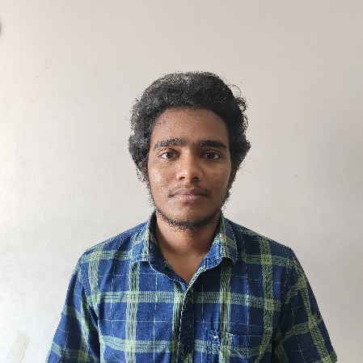




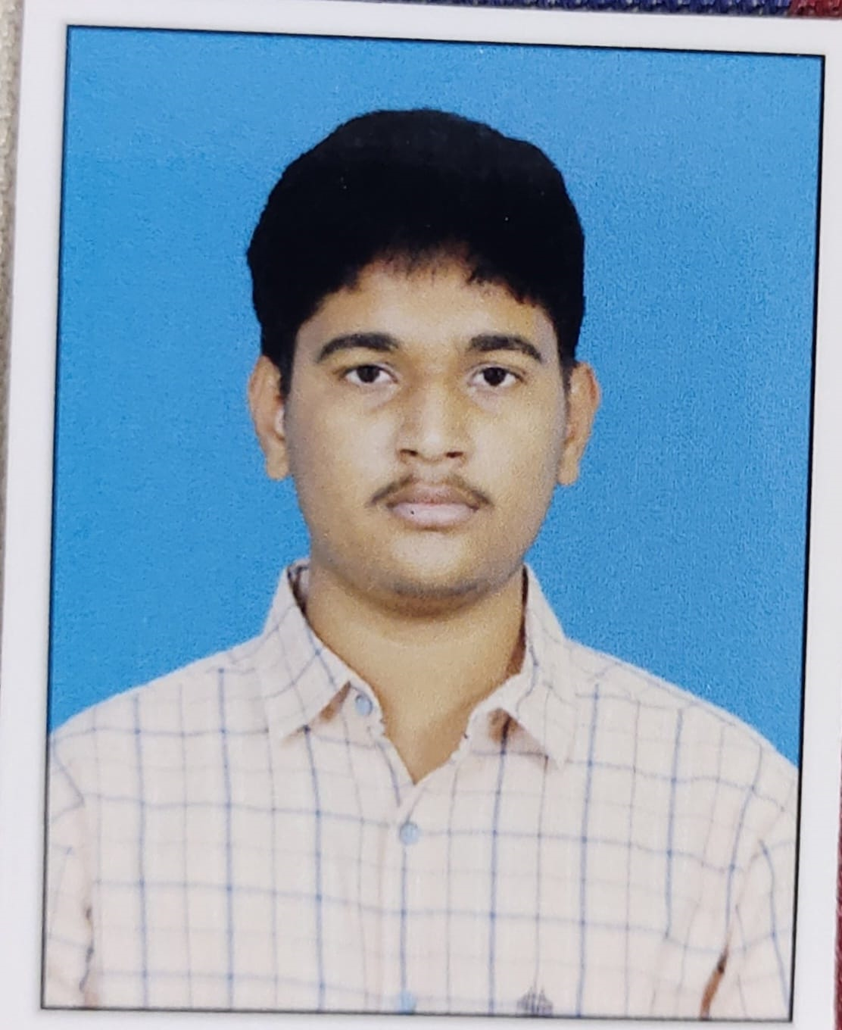
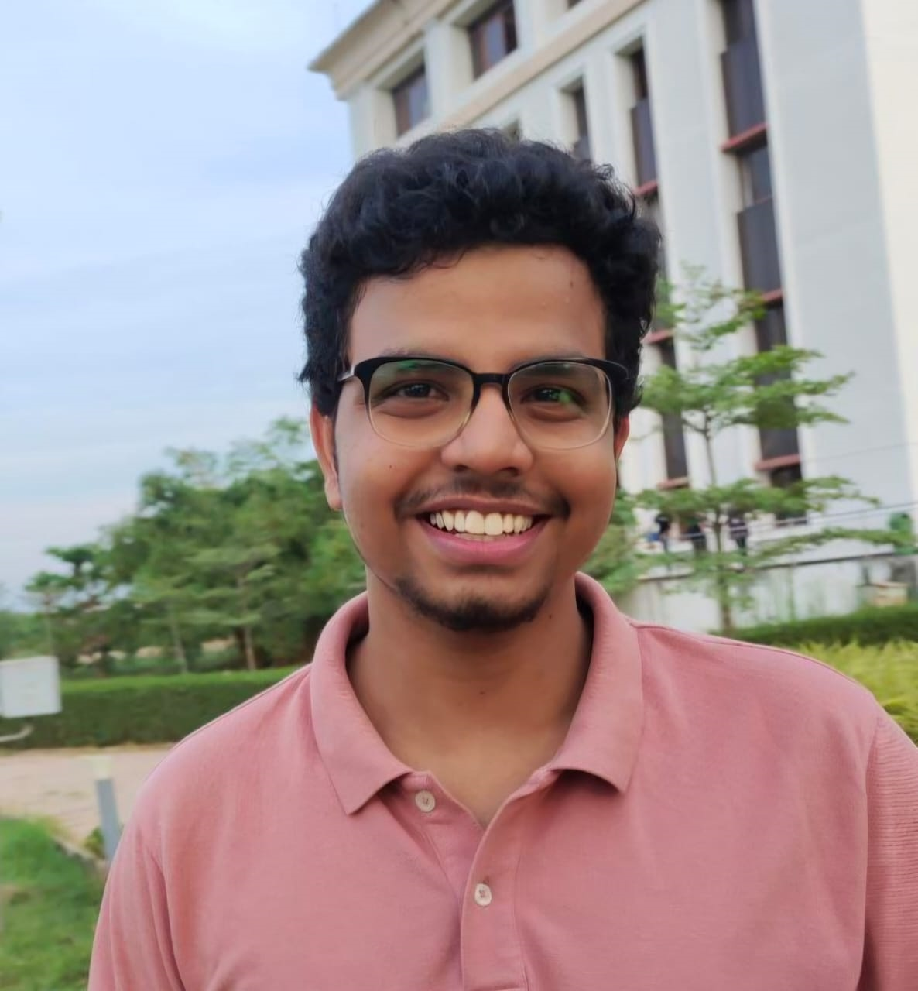

Durga Prasad , Kavali
Jitin, Kaligotla
Student
VIT-AP University
Student
VIT-AP University
Anirudh Gowtham,Chilamkuri
Pavan Kumar , Kundarpu
Student
VIT-AP University
Student
VIT-AP University

Slide 10

Thanks for Joining

